Slide 1
COMM 644 Web Programming Intermediate
Zak Ruvalcaba
Lecture 12
zruvalca@sdccd.edu LinkedIn: linkedin.com/in/zakruvalcaba

Slide 2
This week at a glance…
This week at a glance…
Introduction to Object-Oriented Programming in JavaScript
Object Literals
Object Constructors
ES6 Syntax
Basic Object-Oriented Programming Concepts (Object Constructor and ES6 Class Syntax)
The Four Pillars of Object-Oriented Programming
Encapsulation
Abstraction
Inheritance
Polymorphism
Object Literal Syntax
Lab 19: The Jukebox Application (ES6)
Lab 20: The Task Manager Application v2 (ES5)

Slide 3
Introduction to Object-Oriented Programming in JavaScript

Slide 4
JavaScript OOP
What is Object-Oriented Programming?
Object-Oriented Programming (OOP) is a programming paradigm that uses a concept known as abstraction to create programmatic models based on the real world.
Many popular programming languages such as Java, VB.NET, C#, C++, Python, Ruby, Objective-C, and more support OOP.
OOP can be seen as the design of software using a collection of cooperating objects, as opposed to a traditional view in which a program is seen as a simple list of instructions to/for the computer.
In OOP, each object is capable of receiving messages, processing data, and sending messages to other objects. Each object can be viewed as an independent little machine with a distinct role or responsibility for the overall system.
OOP is intended to promote greater flexibility and maintainability in programming and is widely popular in large-scale software engineering. Because of its strong emphasis on modularity, object-oriented code is intended to be simpler to develop and easier to understand later on.

Slide 5
JavaScript OOP
In JavaScript, everything is based on an object. Everything….
Data Wrapper Objects
String
Utility Objects
Math
Error Objects
Number
Object (everything comes from this, i.e. a “genesis” object)
Boolean
Array
Function
Date
RegExp
Error
EvalError
RangeError
ReferenceError
SyntaxError
TypeError

Slide 6
JavaScript OOP
Three different categories of objects in JavaScript
In the previous slide you looked at some of the object types that we've reviewed throughout this course. But these represent only one third of the types of objects that you can work with in JavaScript. In all, there are 3 object categories in JavaScript:
Native Objects let name = 'Zak';
Host / Browser Objects alert('Hello World');
window
User-Defined Objects const obj = new Object();
String
Defined by You
document
forms
…
Number
Array
Date
…
User-Defined Objects are the primary focus of this lecture

Slide 7
JavaScript OOP
Prototypical Programming vs. Class-Based Programming
With traditional programming languages, objects are unique instances of classes. Classes serve as blueprints for the objects that you create. More on this later. For now, understand that JavaScript is a prototypical programming language, not a class-based language.
ES5 is Prototypical Prototypical programming is a style of OOP in which classes are not present. Behavior reuse (known as inheritance in class-based languages) is accomplished through a process of decorating existing objects which serve as prototypes.
ES6 is Class-based (well sort of) In ES6, the prototypical programming style of ES5 has been enhanced with a class-based style which is common of all object-oriented programming languages. Keep in mind though, although ES6 allows you to use keywords that mimic traditional OOP languages, the reality is, these keywords merely provide 'syntactical sugar' for the traditional methods of creating objects that have been present with JavaScript for many years.

Slide 8
JavaScript OOP
Prototypical Programming vs. Class-Based Programming
Class-based object-oriented languages are founded on the concept of two distinct entities: classes and instances.
Class Defines all of the members that characterize a certain set of objects. It's an abstract thing, a blueprint, or a recipe. For example, a class called Cat could represent all cats in a virtual world.
Instance Is the instantiation of a class. For example, Nixon (my cat) could be an instance of the Cat class, representing a particular Cat, with its own unique physical characteristics.
A prototypical language such as JavaScript, does not make this distinction: it simply has objects. A prototypical language has the notion of a prototypical object, an object used as a template from which to get the initial properties for a new object. Any object can specify its own properties, either when you create it or at run time. In addition, any object can be associated as the prototype for another object, allowing the second object to share the first object's properties.

Slide 9
JavaScript OOP
User Defined Objects: Three ways of creating them
With Native Objects, you're using properties and methods that already exist for each object. User Defined Objects on the other hand, allow you to create your own objects and define the properties and methods that you want to expose within those objects. In JavaScript, there are three common ways to create objects:
User Defined Objects
Object Literal
Object Constructor
ES6 Syntax
An object literal is a comma-separated list of name-value pairs wrapped in curly braces.
ES6 Syntax represents the newest way to blueprint objects.
When a function is called with the 'new' operator, the function serves as the constructor.
Internally, JavaScript creates an Object, and then calls the constructor function.

Slide 10
JavaScript OOP
User Defined Objects: Object Literal vs. Object Constructor vs. ES6 Syntax
Object Literal
Object Constructor
Scope Properties and methods can be private/public.
Scope Properties and methods are always public.
By Ref When a Constructor function is instantiated and then a change is made to that instance, it won't affect any other instances of that object.
By Val When a change is made to an Object Literal it affects that object across the entire script.
ES6 Syntax
Scope Properties and methods can be private/public.
By Ref When a Constructor function is instantiated and then a change is made to that instance, it won't affect any other instances of that object.
const Cat = {
name: 'Nixon',
breed: 'Bengal',
color: 'Snow Mink'
};
console.log(Cat.name);
function Cat() {
this.name = 'Nixon';
this.breed = 'Bengal';
this.color = 'Snow Mink';
}
const myCat = new Cat();
console.log(myCat.name);
class Cat {
constructor(name) {
this.name = name;
}
}
const myCat = new Cat('Nixon');
console.log(myCat.name);

Slide 11
Basic Object-Oriented Programming Concepts

Slide 12
JavaScript OOP
Common OOP Terms
Class Defines the characteristics of an object. Think Cat or Dog.
Namespace Container which allows you to bundle up multiple classes under a unique name. Think Animal.
Object An Instance of a class.
Property An object's characteristics. Think breed, eye color, weight, length, width, etc.
Method An object's ability to do something. Think speak, walk, run, or eat.
Constructor A method called at the moment an object is created (instantiated).
Encapsulation Illustrates the fact that an object contains (encapsulates) members: data (properties) and the means to do something with that data (methods). Also defines how information within classes can be hidden.
Inheritance A class that inherits characteristics from another class.
Abstraction A computer program's ability to generically model a part of the overall solution.
Aggregation Provides a way to separate a problem into smaller and more manageable parts.
Polymorphism The ability to call the same method on different objects and have each of them respond in their own way. Example: speak method for Animal class. But when Dog class calls speak method it returns a bark. When Cat class calls speak method it returns meow.

Slide 13

JavaScript OOP
Classes
In OOP, a class is a blueprint, or a recipe for an object.
In real life, similar objects can be grouped based on some criteria. A hummingbird and an eagle for instance, are both birds. They can be classified as belonging to some made up Birds class.
Another name for 'object' is 'instance', so we say that the eagle is one concrete instance of the class Birds.
You can create different objects using the same class, because a class is just a template, while the objects are concrete instances based on the template.
Cat

Slide 14
JavaScript OOP
Classes
ES5 Since there is no specific syntax for defining a class in ES5, functions are used to simulate them:
Named Class Anonymous Class function Cat() {} const Cat = function() {}
* You can't use arrow functions when defining classes in ES5. Remember, arrow functions are an ES6 concept and doing so will eliminate the ability for you to be able to use the keyword this. More on this keyword later. this keyword is important because that’s how you create Properties.
ES6
class Cat {
}
or

Slide 15

JavaScript OOP
Namespaces
A namespace is a container which allows the programmer to bundle up multiple classes under a unique name.
We know that Cats are not the only animals that exist in nature. Dogs are animals too. Now imagine a Dog class. Both Cat and Dog classes can be bundled together under the same Animal namespace.
JavaScript does not currently support namespaces like other programming languages do. This is just an OOP concept that you should know.
Animal
Cat
Dog

Slide 16
JavaScript OOP
Objects
As the name object-oriented suggests, objects are important. An object is a representation of a 'thing' (someone or something). Using our Cat class as an example…it has certain characteristics (color, breed, height, weight, and so on) and can perform some actions (eat, sleep, walk, run, and so on). The characteristics of the object are properties, and the actions are methods. Let's see how this translates to spoken languages:
Objects are most often named using nouns (Dog, Cat, Bird, and so on)
Methods are verbs (run, walk, eat, and so on)
Values of the properties are adjectives (weight, color, breed, height, and so on)
Take the sentence 'The black cat sleeps on the mat'. 'The cat' (a noun) is the object, 'black' (adjective) is the value of the color property, and 'sleep' (a verb) is an action, or a method in OOP. For the sake of this analogy, we can go a step further and say that 'on the mat ' specifies something about the action 'sleep', so it's acting as a parameter passed to the sleep method.

Slide 17
JavaScript OOP
Instantiation
To create a new instance of a class we use a process known as instantiation.
Instantiation creates a new instance of a class and temporarily stores it within an object variable.
In this example, we define a class and then we instantiate three unique object variable instances.
Cat 1
Cat 2
Cat
Cat 3

Slide 18
JavaScript OOP
Instantiation
Instantiation creates a new instance of a class and temporarily stores it within an object variable:
class Cat {
} const cat1 = new Cat(); // Unique instance of the Cat class const cat2 = new Cat(); // Unique instance of the Cat class const cat3 = new Cat(); // Unique instance of the Cat class
* The process of instantiation is the same in ES5 and ES6.

Slide 19
JavaScript OOP
The Constructor
name: Nixon
In most OOP languages, the constructor is a special type of method that executes immediately when the class is instantiated.
The constructor is a great way to set important properties for an object upon its instantiation. The VIN number for a new Car for instance or the name of a cat. These are important properties that you would want to set immediately upon creation of the object.
In ES5, the function serves as the constructor of the object. In ES6, a special constructor method is used instead.
name: Reagan
Cat
name: Chamberlain

Slide 20
JavaScript OOP
The Constructor
ES5 function Cat() {
console.log(`The new cat has been created!`);
}
const cat1 = new Cat(); // Text is immediately displayed in console
ES6
class Cat {
constructor() {
console.log(`The new cat has been created!`);
}
}
const cat1 = new Cat(); // Text is immediately displayed in console
Constructor is the body of the function.
Constructor is typically used to set Properties, which then are used to do something via a method.

Slide 21

JavaScript OOP
Properties
Properties are characteristics of a class.
Once you instantiate a class as an object, that object instance will inherit any properties defined within the class.
Think about the characteristics that a cat has including color, breed, eye color, height, length, width, weight, etc. These are the properties that you would define when blueprinting a Cat class.

Slide 22
JavaScript OOP
Properties (ES5)
Working with properties from within the class is done using the keyword this, which refers to the current object:
function Cat(breed, color) {
this.breed = breed;
this.color = color;
this.age = 0;
console.log(`The new ${this.color} ${this.breed} has been created!`);
}
const nixon = new Cat('Bengal', 'Snow Mink');

Slide 23
JavaScript OOP
Properties (ES6)
Properties in ES6 are defined in a similar fashion to ES5. Within the constructor, set any properties using the following syntax:
class Cat {
constructor(breed, color) {
this.breed = breed;
this.color = color;
this.age = 0;
console.log(`The new ${this.color} ${this.breed} has been created!`);
}
}
const nixon = new Cat('Bengal', 'Snow Mink');
* In ES6, properties set within the constructor will not be publicly accessible. In order to create publicly accessible properties, you'll have to use getters and setters.

Slide 24

JavaScript OOP
Methods
Methods are things that an object will be able to do or actions that it can perform once the object has been instantiated.
When designing a game, methods are what you want the person playing your game to be able to do. Pac Man can move up, move down, move left, move right, eat pellets, eat ghosts, die, eat a power pellet, eat a fruit, etc.
As it relates to our class, a cat can meow, sleep, scratch, etc.
Methods are easy to spot because they usually include a set of parentheses after the identifier.

Slide 25
JavaScript OOP
Methods (ES5)
Methods in ES5 are defined using nested functions:
function Cat(breed, color) {
this.breed = breed;
this.color = color;
this.meow = function() {
console.log(`The ${this.color} ${this.breed} has meowed!`);
}
}
const nixon = new Cat('Bengal', 'Snow Mink');
nixon.meow();

Slide 26
JavaScript OOP
Methods (ES6)
Methods in ES6 are defined similarly to how they are defined in ES5:
class Cat {
constructor(breed, color) {
this.breed = breed;
this.color = color;
}
meow = function() {
console.log(`The ${this.color} ${this.breed} has meowed!`);
}
}
const nixon = new Cat('Bengal', 'Snow Mink');
nixon.meow();

Slide 27
JavaScript OOP
Static Methods (ES6)
Classes in ES6 can also contain static methods. A static method is a function that is bound to the class, not an object:
class Cat {
constructor(breed, color) {
this.breed = breed;
this.color = color;
}
meow = function() {
console.log(`The ${this.color} ${this.breed} has meowed!`);
}
static eat = function() {console.log('Now he\'s eating!')};
}
const nixon = new Cat('Bengal', 'Snow Mink');
nixon.meow();
Cat.eat();

Slide 28
The Four Pillars of Object-Oriented Programming

Slide 29

JavaScript OOP
Encapsulation
Encapsulation is achieved when each object keeps its state private, inside a class. Other objects don’t have direct access to this state. Instead, they can only call a list of public methods.
Let’s say we’re building a tiny Sims game. There are people and there is a cat. They communicate with each other. We want to apply encapsulation, so we encapsulate all "cat" logic into a Cat class.
Here the "state" of the cat is the private variables mood, hungry and energy and the private method meow(). It can call it whenever it wants, the other classes can’t tell the cat when to meow. What they can do is defined in the public methods sleep(), play() and feed(). Each of them modifies the internal state somehow and may invoke meow(). Thus, the binding between the private state and public methods is made.

Slide 30
JavaScript OOP
Encapsulation - Defining Private Members
function Cat(breed) {
let _breed = breed; // Private property using keyword 'let'
let displayBreed = function() { // Private Method using keyword 'let'
console.log(`The breed of cat is ${_breed}.`);
}
this.showBreedOfCat = function() { // Public Method
displayBreed();
}
} const nixon = new Cat('Bengal');
nixon.showBreedOfCat(); // Returns: The breed of cat is Bengal
nixon.breed; // Does nothing
nixon.displayBreed(); // TypeError: nixon.displayBreed is not a function

Slide 31
JavaScript OOP
Encapsulation - Defining Public Members
Using constructor syntax, you can also attach methods to the object's prototype. In this case, the displayBreed() method is added to the Cat object's prototype chain and is accessible once the class has been instantiated. Creating public properties is as simple as using the keyword this:
function Cat(breed) {
this.breed = breed;
}
Cat.prototype.displayBreed = function() {
console.log(`The breed of cat is ${this.breed}.`);
}
const nixon = new Cat('Bengal');
console.log(nixon.breed); // Returns: Bengal
nixon.displayBreed(); // Returns: The breed of cat is Bengal

Slide 32
JavaScript OOP
Encapsulation in ES6 with getters and setters
class Cat {
constructor(breed, color) {
this._breed = breed;
this._color = color;
}
get breed() {return this._breed}
set breed(newBreed) {this._breed = newBreed}
}
const nixon = new Cat('Bengal', 'Snow Mink');
console.log(nixon.breed); // Returns: Bengal
nixon.breed = 'Siamese';
console.log(nixon.breed); // Returns: Siamese

Slide 33
JavaScript OOP
Abstraction
Abstraction can be thought of as a natural extension of encapsulation.
In object-oriented design, programs are often extremely large. And separate objects communicate with each other a lot. So, maintaining a large codebase like this for years, with changes along the way, is difficult.
Abstraction is a concept aimed at easing this problem.
Applying abstraction means that each object should only expose a high-level mechanism for using it.
This mechanism should hide internal implementation details. It should only reveal operations relevant for the other objects.
Think about a coffee machine. It does a lot of stuff and makes quirky noises under the hood. But all you have to do is put in coffee, press a button and like magic, it works!

Slide 34

JavaScript OOP
Abstraction
Another real-life example of abstraction? Think about how you use your phone.
You interact with your phone by using only a few buttons. What’s going on under the glass? You don’t have to know — implementation details are hidden. You only need to know a short set of actions.
Implementation changes, for example, a software update, rarely affect the abstraction you use.

Slide 35
JavaScript OOP
Inheritance
We've seen how encapsulation and abstraction can help us develop and maintain a big codebase.
But there's another common problem in OOP design and that's the fact that objects are often very similar. They share common logic. But they’re not entirely the same.
How do we reuse the common logic and extract the unique logic into a separate class? One way to achieve this is inheritance.
It means that you create a child class or sub class by deriving from another parent class. This way, we form a hierarchy.
The child class reuses all fields and methods of the parent class (common part) and can implement its own (unique part).

Slide 36

JavaScript OOP
Inheritance
In this example, a private teacher is a type of teacher. And any teacher is a type of Person.
If our program needs to manage public and private teachers, but also other types of people like students, we can implement this class hierarchy.
This way, each class adds only what is necessary for it while reusing common logic with the parent classes.

Slide 37
JavaScript OOP
An Example that Demonstrates Inheritance – The Vehicle and Car Classes
The Vehicle Class
const Vehicle = function(make, model) {
this.make = make;
this.model = model;
this.miles = 0;
}
Vehicle.prototype.drive = function(miles) {
this.miles += miles;
console.log(`Your ${this.doors} door ${this.make} ${this.model} has driven ${this.miles} miles.`);
}
Note: because .doors is not a defined property of the Vehicle class, .doors will not be available for Vehicle objects. It’s put in here solely for the use of the inheriting Car object which has a .doors property.
The Car Class
const Car = function(doors) {
this.doors = doors;
}

Slide 38
JavaScript OOP
An Example that Demonstrates Inheritance – Extending
'The Car class extends the Vehicle class' or 'the Car class inherits from the Vehicle class' Car.prototype = new Vehicle('Chevy', 'Camaro'); Code that implements the Car Class
const myCar = new Car(4);
myCar.drive(2000);
Look at the result in the console window!

Slide 39
JavaScript OOP
Inheritance in ES6 with the extends keyword and super() method
There’s a few important things to note as it relates to inheritance in ES6. First, let's consider this class for Vehicle: class Vehicle {
constructor(make, model, miles) {
this.make = make;
this.model = model;
this.miles = 0;
}
drive = function(miles) {
this.miles += miles;
console.log(`Your ${this.doors} door ${this.make} ${this.model} has driven ${this.miles} miles.`);
}
}

Slide 40
JavaScript OOP
Inheritance in ES6 with the extends keyword and super() method
When we create the child class, we need to state that it extends the parent class. Then we need to pass whatever properties we want to inherit from the parent to the child’s constructor: class Car extends Vehicle {
constructor(make, model, doors) {
super(make, model);
this.doors = doors;
}
}
const myCar = new Car('Chevy', 'Camaro', 4);
myCar.drive(2000);
Next, we call the super() method. Notice that we pass it the values that we pass the child class when creating the myCat object. These values are defined in the parent’s constructor, so we need to run it in order for the values to be instantiated. Now we can define our child class’s properties and methods.

Slide 41

JavaScript OOP
Polymorphism
We’re down to the most complex word! Polymorphism.
This sketch represents an implementation of geometric figures. They reuse a common interface for calculating surface area and perimeter.
But we know that the formula for calculating the surface area and perimeter for different shapes is different.
Polymorphism makes it so that you can use the same interface but achieve different results based on the object using the interface.

Slide 42
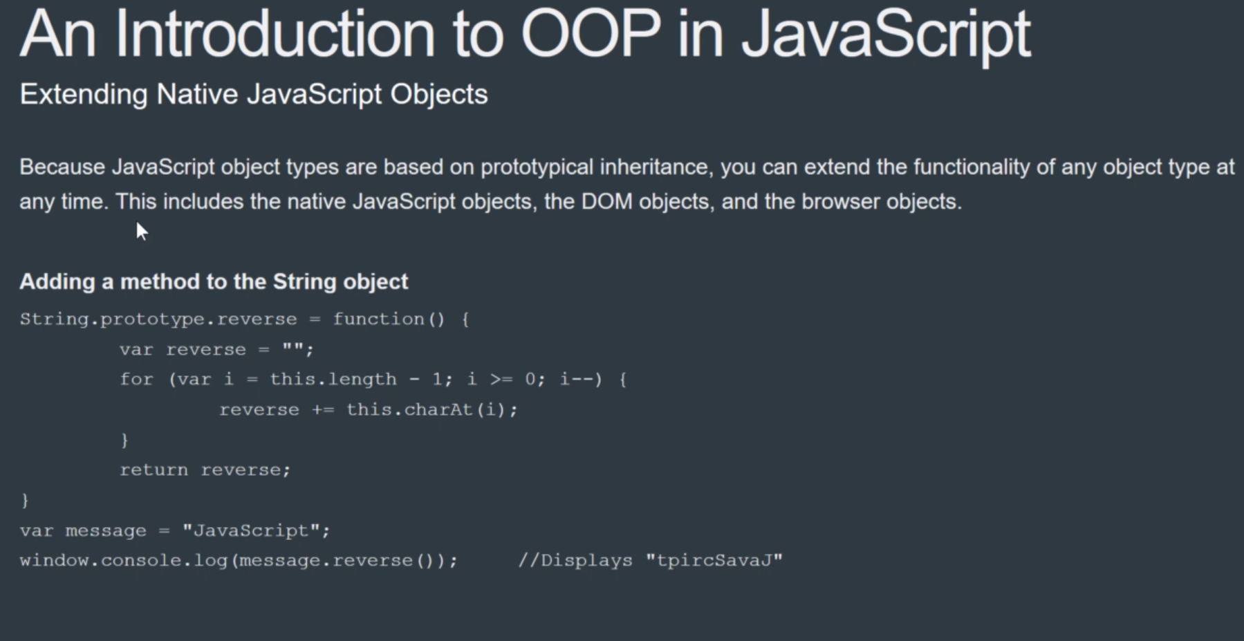

Slide 43
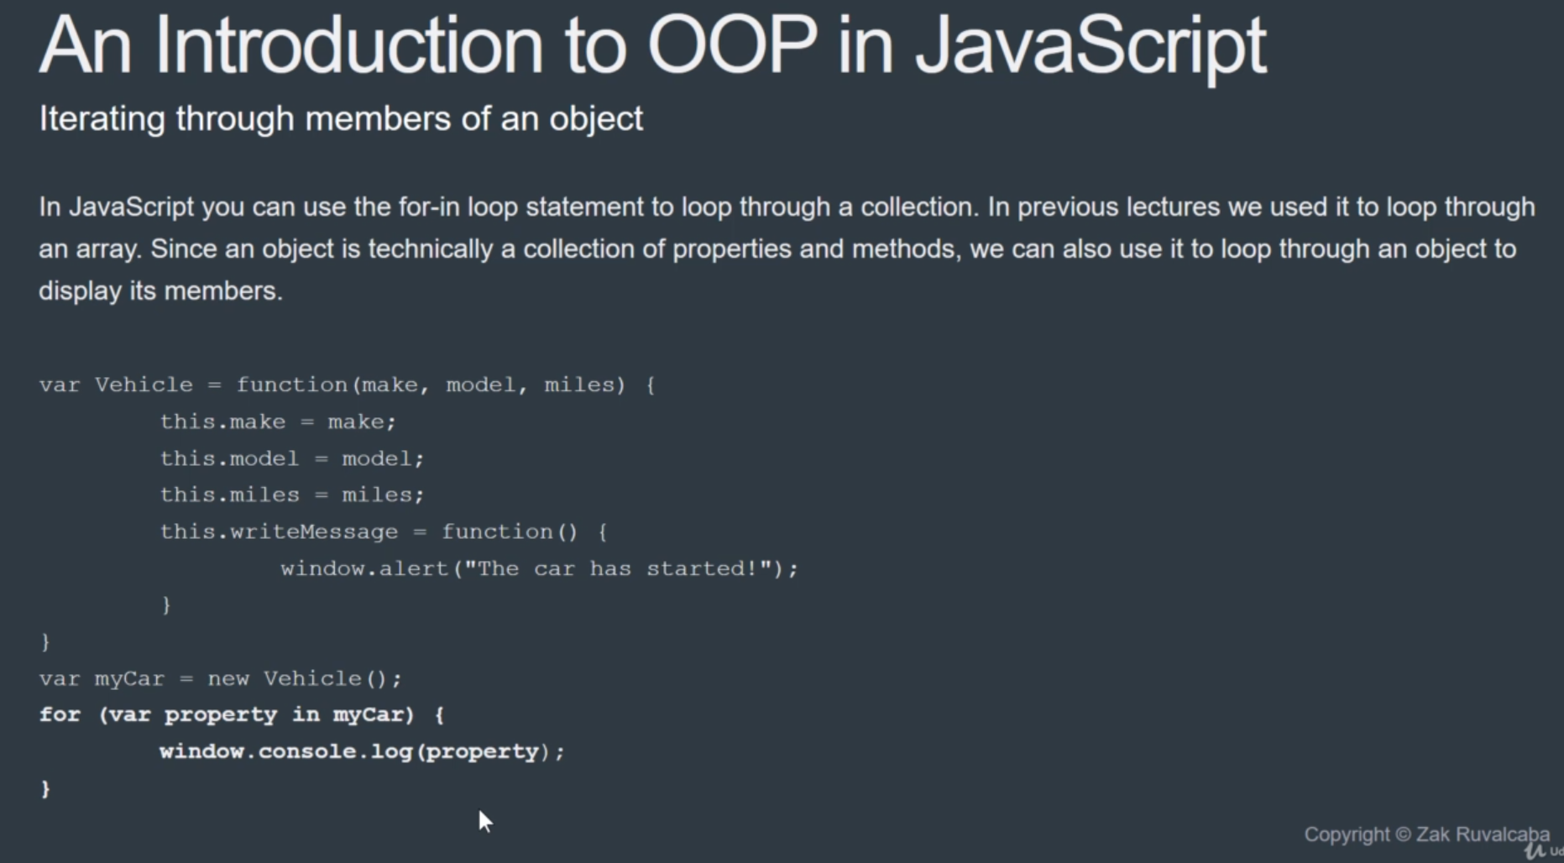

Slide 44
Object Literals

Slide 45
Working with Objects
Object Literal syntax
Object Literal notation is a common method for defining objects in JavaScript. I would get used to this format as you WILL see this a lot. A typical Object Literal will look like this:
const Cat = {
name: 'Nixon',
displayCatInfo: function(breed, color) {
return `${this.name} is a ${color} ${breed}`;
}
}
console.log(Cat.displayCatInfo('Bengal', 'Snow Mink'));
console.log(Cat.name);
Property
Method
References make property inside of this (Cat) object.
Accessing the method
Accessing the property

Slide 46
Working with Objects
Object Literal alternate syntax
Object Literal notation can also be written in this manner:
const Cat = {};
// or const Cat = new Object();
Cat.name = 'Nixon';
Cat.displayCatInfo = function(breed, color) {
return `${this.name} is a ${color} ${breed}`;
}
console.log(Cat.displayCatInfo('Bengal', 'Snow Mink'));
console.log(Cat.name);

Slide 47
Working with Objects
Modifying members
The nice thing about Object Literal notation is that their properties are always public. This allows us to override their properties outside of the object like this: const Cat = {
name: 'Nixon',
displayCatInfo: function(breed, color) {
return `${this.name} is a ${color} ${breed}`;
}
}
Cat.name = 'Reagan';
console.log(Cat.displayCatInfo('Siamese', 'White'));
console.log(Cat.name);

Slide 48
Working with Objects
Adding members
Sometimes, it makes sense to add properties and methods to an object programmatically:
const Cat = {
name: 'Reagan',
displayCatInfo: function(breed, color) {
return `${this.name} is a ${color} ${breed}`;
}
}
Cat.hungry = true;
console.log(Cat.displayCatInfo('Siamese', 'White'));
console.log(`The cat is ${Cat.hungry ? 'hungry' : 'not hungry'}.`);

Slide 49
Working with Objects
Removing members
Sometimes it makes sense to remove properties and methods from an object programmatically:
const Cat = {
name: 'Reagan',
displayCatInfo: function(breed, color) {
return `${this.name} is a ${color} ${breed}`;
}
}
Cat.hungry = true;
delete Cat.hungry;
console.log(Cat.displayCatInfo('Siamese', 'White'));
console.log(`This cat is ${Cat.hungry ? 'hungry' : 'not hungry'}.`);

Slide 50
Working with Objects
Nesting objects
Nesting an object within an object is common. For those who come from a traditional programming background, Animal here begins to look a lot like a namespace and Cat begins to look a lot more like a class:
const Animal = {
Cat: {
name: 'Nixon',
breed: 'Bengal',
color: 'Snow Mink'
}
} You can refer to a nested object like this:
console.log(Animal.Cat.name);
console.log(Animal.Cat.breed);
console.log(Animal.Cat.color);

Slide 51
Working with Objects
Inheritance
Earlier you saw how to handle inheritance by utilizing the prototype property to inherit one object from another. The syntax for accomplishing this using literal notation is slightly more convoluted but can still be accomplished like this:
const Animal = {
breed: 'Bengal'
};
const Cat = Object.create(Animal);
console.log(Cat.breed); // Returns 'Bengal'

Slide 52
Working with Objects
Inheritance
A more practical example might look like this:
const Animal = {
name: 'Nixon',
displayCatInfo: function(breed, color) {
return `${this.name} is a ${color} ${breed}`;
}
};
const Cat = Object.create(Animal, {
name: {value: 'Reagan'}
}); console.log(Cat.displayCatInfo('Siamese', 'White')); console.log(Cat.name); console.log(Cat.breed);

Slide 53
Lab 19 The Jukebox Application (ES6)

Slide 54
Lab 20 The Task Manager Application v2 (ES5)

